Slide 1
Compiling parliamentary corpora, Hands-on
Andrej Pančur¹, Tomaž Erjavec²
Institute of Contemporary History¹,
Department of Knowledge Technologies, Jožef Stefan Institute²
PARTHENOS Workshop for CEE countries
Sofia, October 7–9, 2019

Slide 2
Before you start making a corpus:
Know your data,
where it comes from,
what's in it,
what it means.

Slide 3
While creating a corpus, be aware that you never know your data sufficiently. Therefore, once again:
Know your data,
where it comes from,
what's in it,
what it means.

Slide 4
Parliaments use different methods for parliamentary records:
Shorthand writing
Stenotyping
Digital recording
Voice recognition

Slide 5
Parliamentary reports can be very different:
Public sessions or confidential meetings
Verbatim or summary
Plenary or Committees
Unrevised text or speakers corrections

Slide 6
Speakers corrections
Almost never 100% verbatim linguistic transcriptions
Elimination of some typical characteristics of spoken language
Elimination of obvious language or factual errors, dialectal or colloquial expressions, rude and obscene language, etc.
Standardization
Comments
Parliaments use one or more revising levels:
Only conventions
Stricter guidelines
Try to get these guidelines!

Slide 7
Different parliamentary rules and conventions in different countries
Turn-taking:
prohibited interruptions
tolerated interruptions
regulated interruptions
allowed interruptions
Place:
Podium
speaker box
bench

Slide 8
BUT: Parliamentary debates are typically formatted in a uniform way, which fluctuates very little in time. Slovenian example:
Document (1, n)
Table of contents (0, 1)
List of speakers (0, 1)
Index (0, 1)
Annex (0, n)
Meeting (1, n)
Non-verbal content (0, n)
Topic (1, n)
Non-verbal content (0, n)
Speech (1, n)
Non-verbal content (0,n)
Paragraph (1, n)
Non-verbal content (0, n)

Slide 9
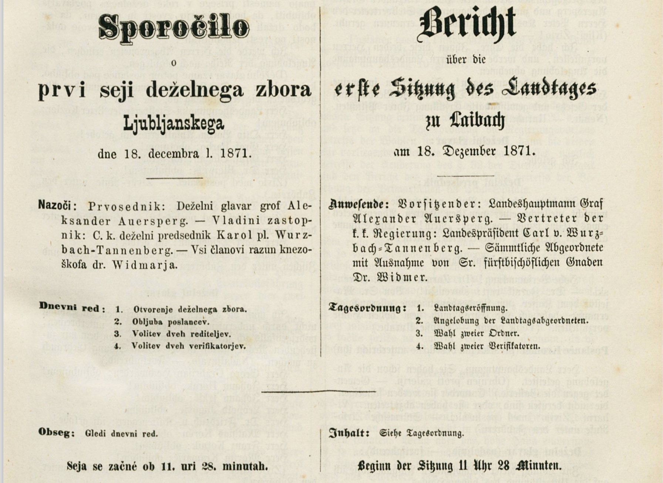
Austrian regional parliament (Carniola) 1871

Slide 10
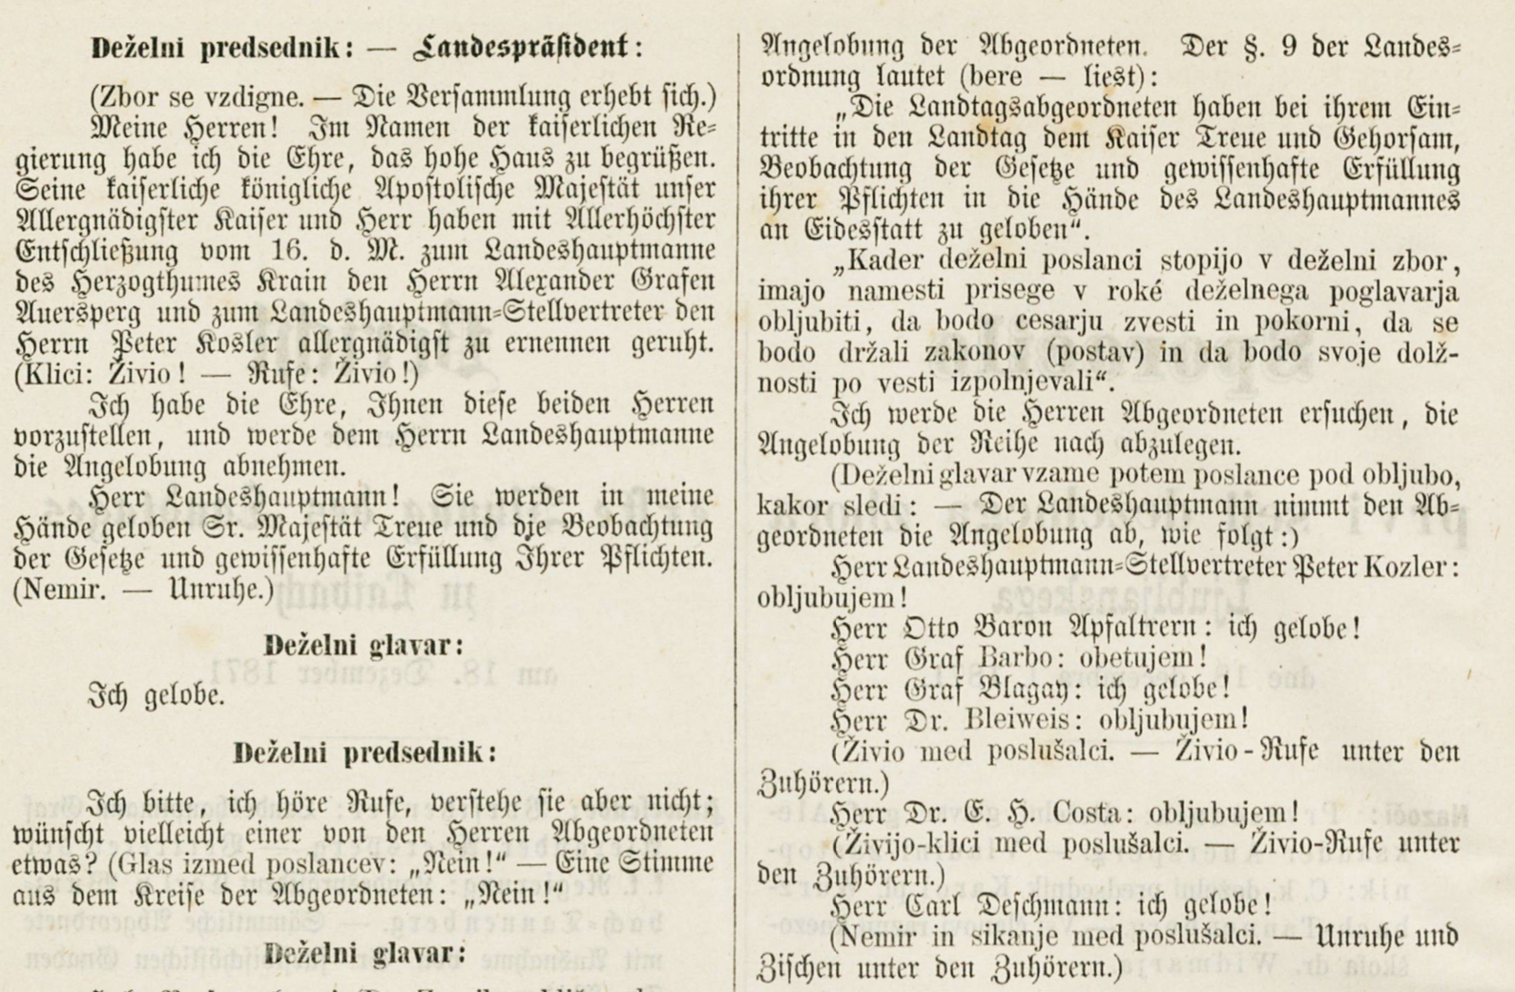

Slide 11
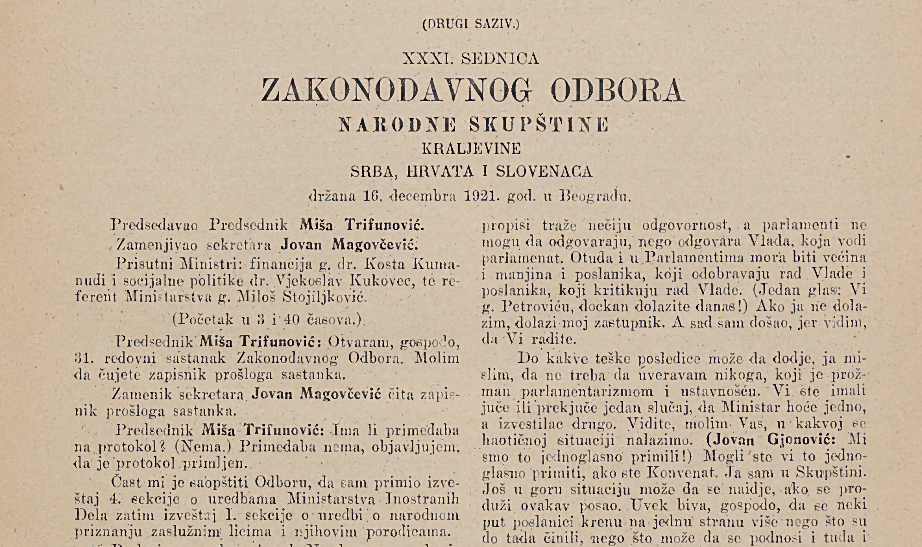
Yugoslav Parliament 1921

Slide 12
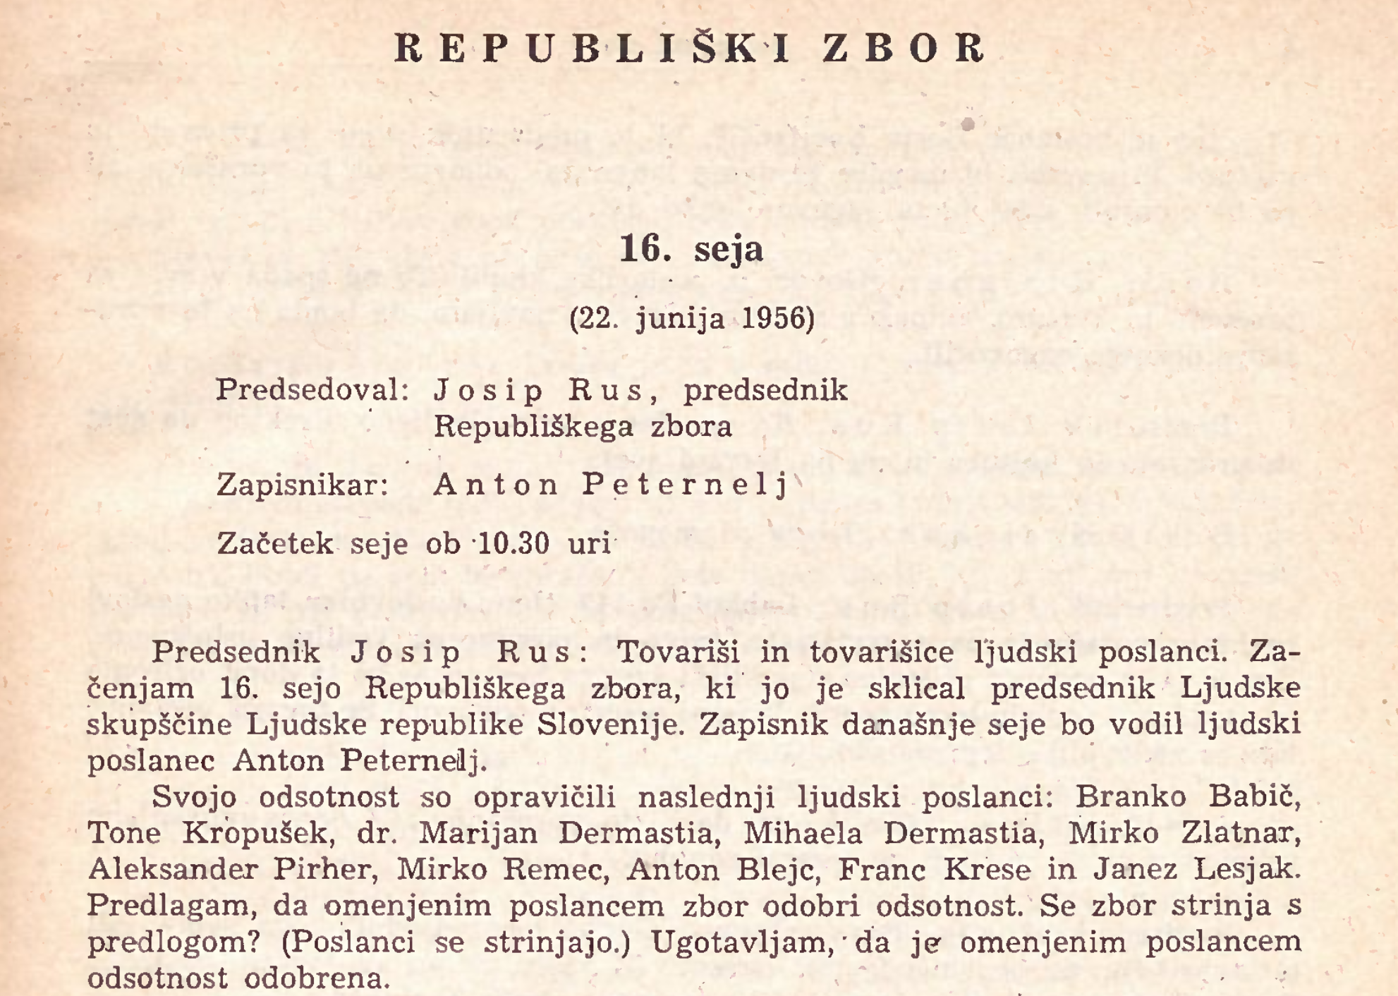
Slovenian regional parliament 1956

Slide 13
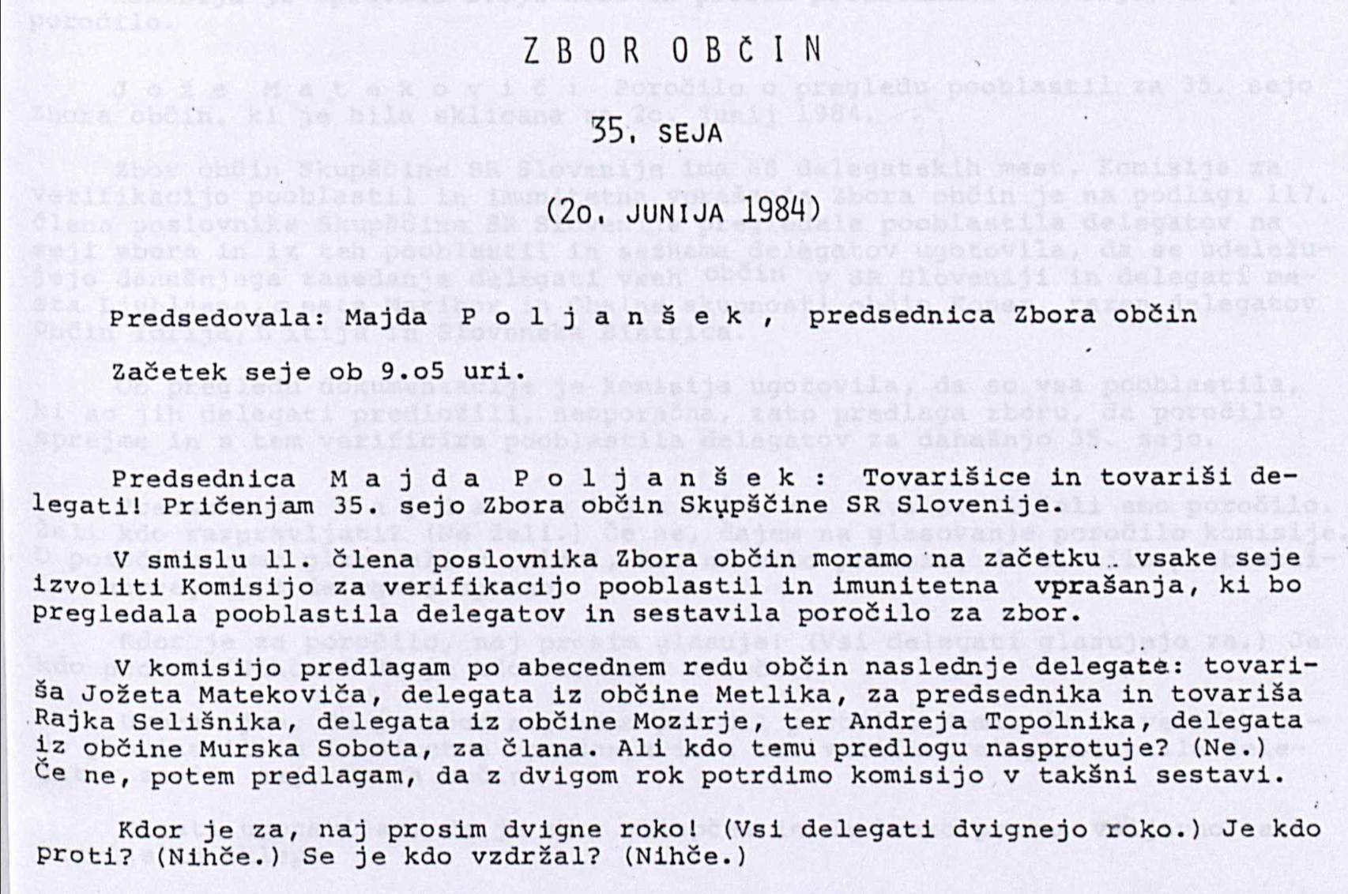
Slovenian regional parliament 1984

Slide 14
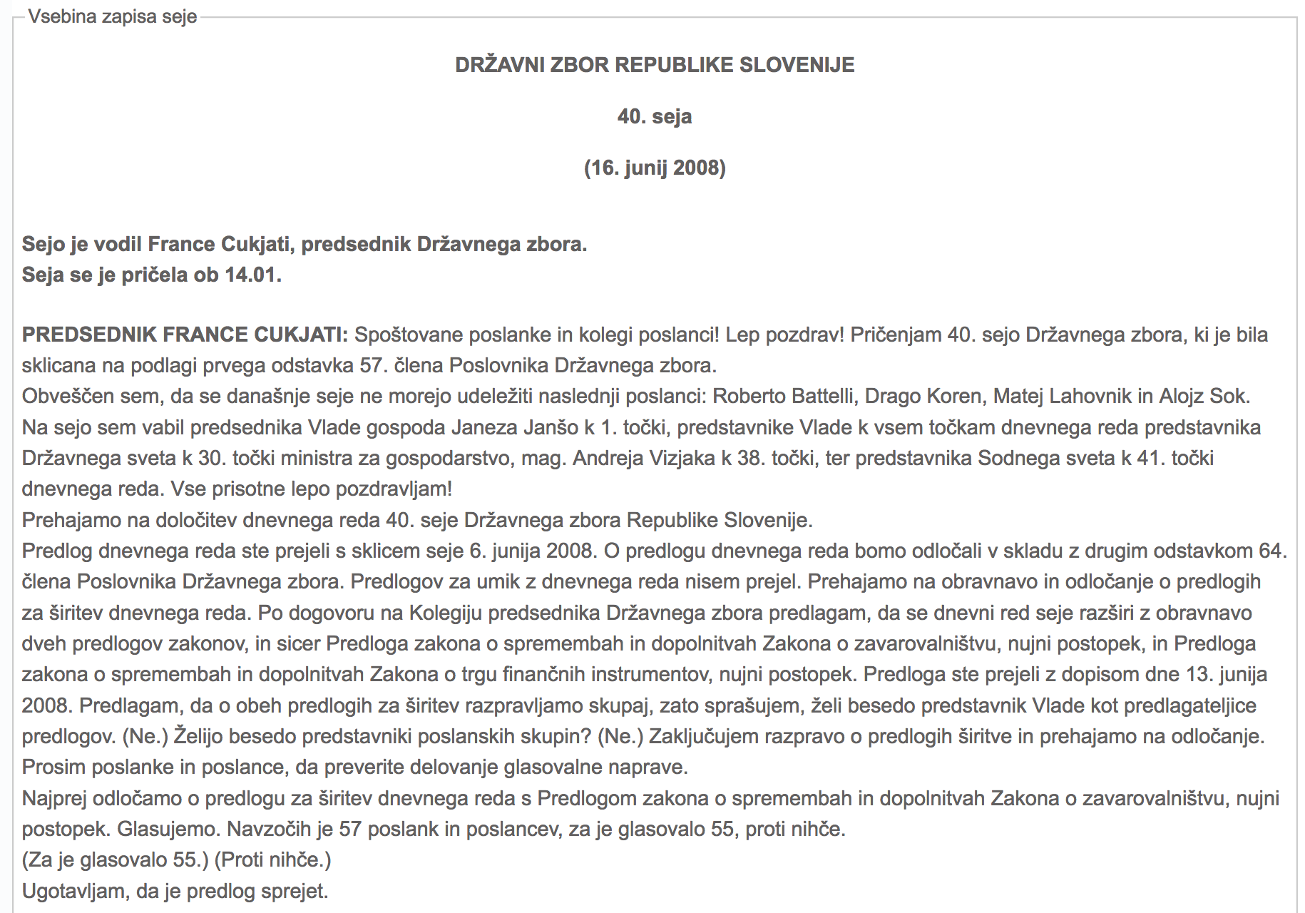
Slovenian parliament 2008

Slide 15
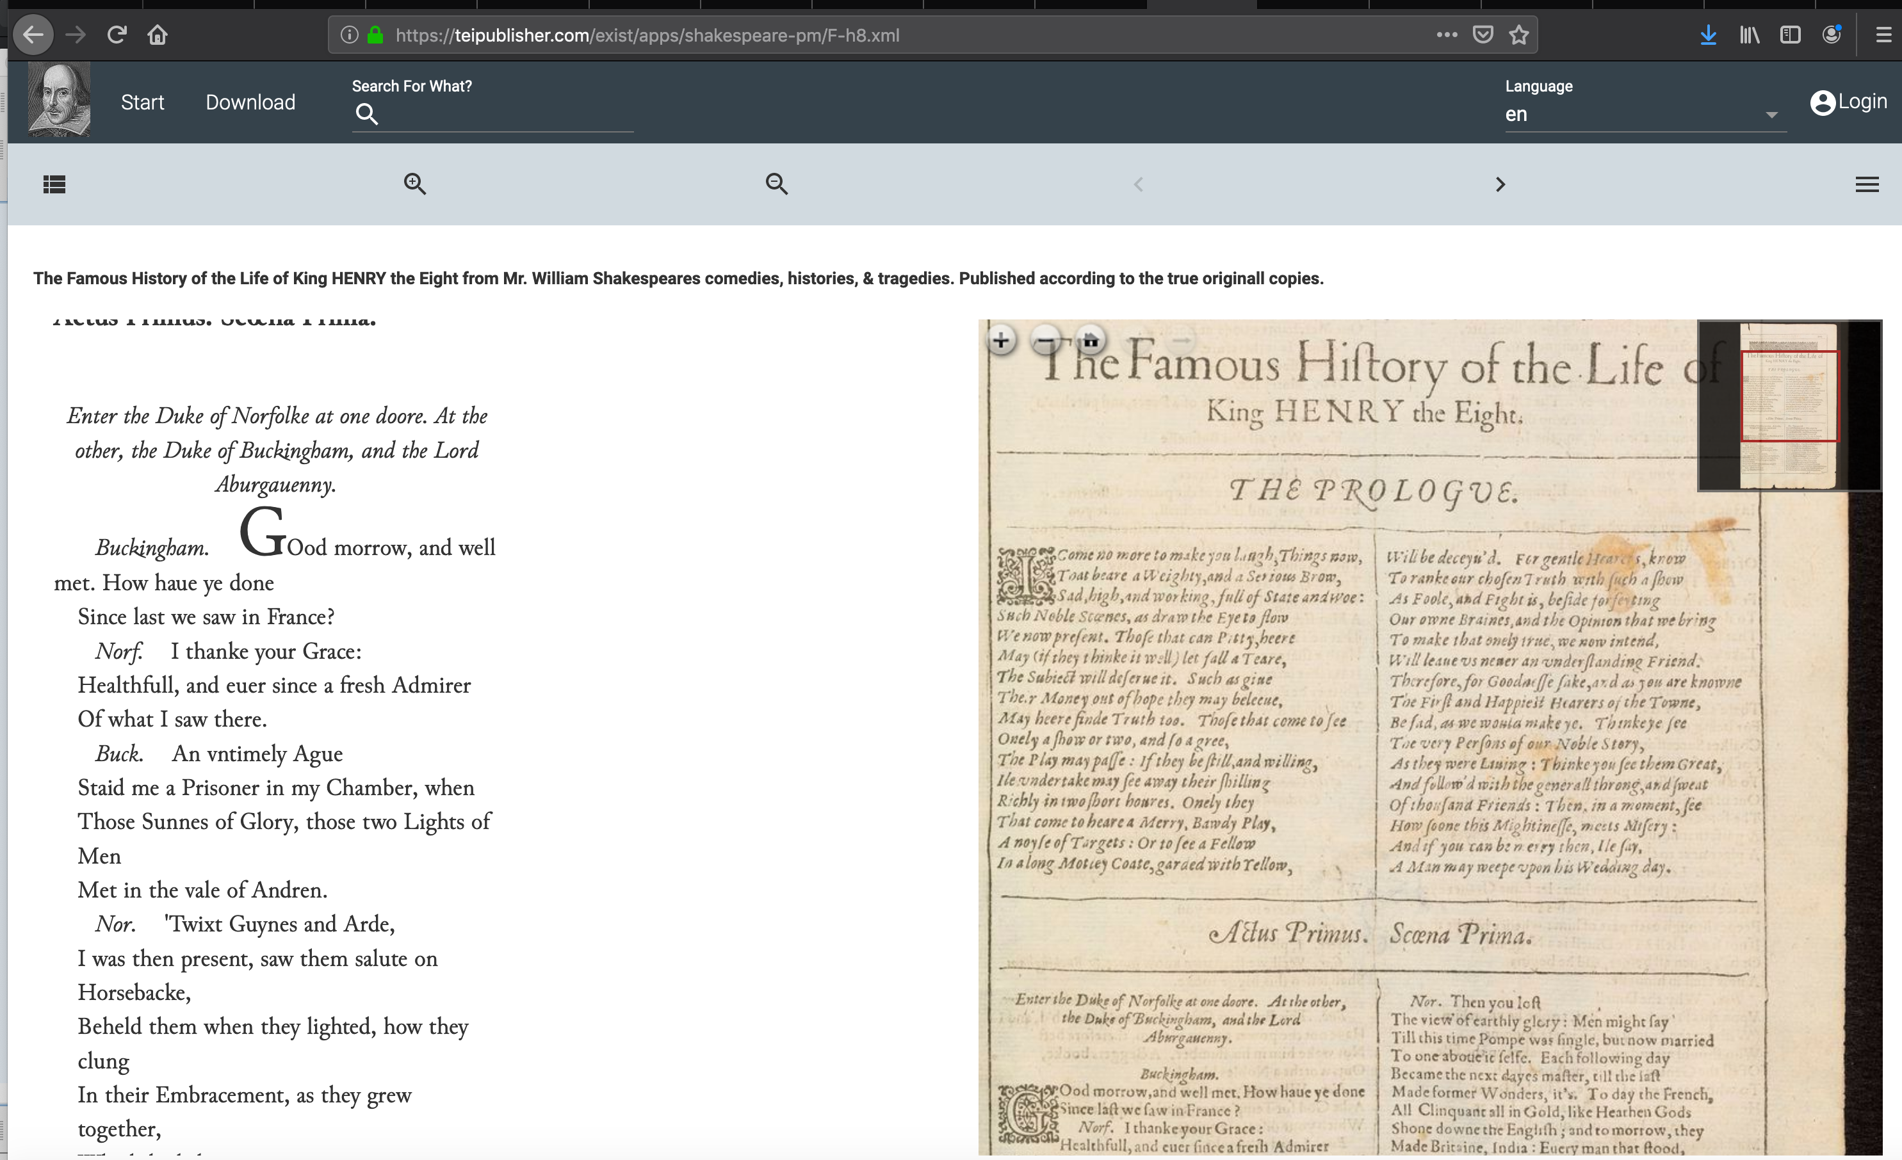
Parliamentary debates as performance texts (dramatic texts, screen plays or radio scripts)?

Slide 16
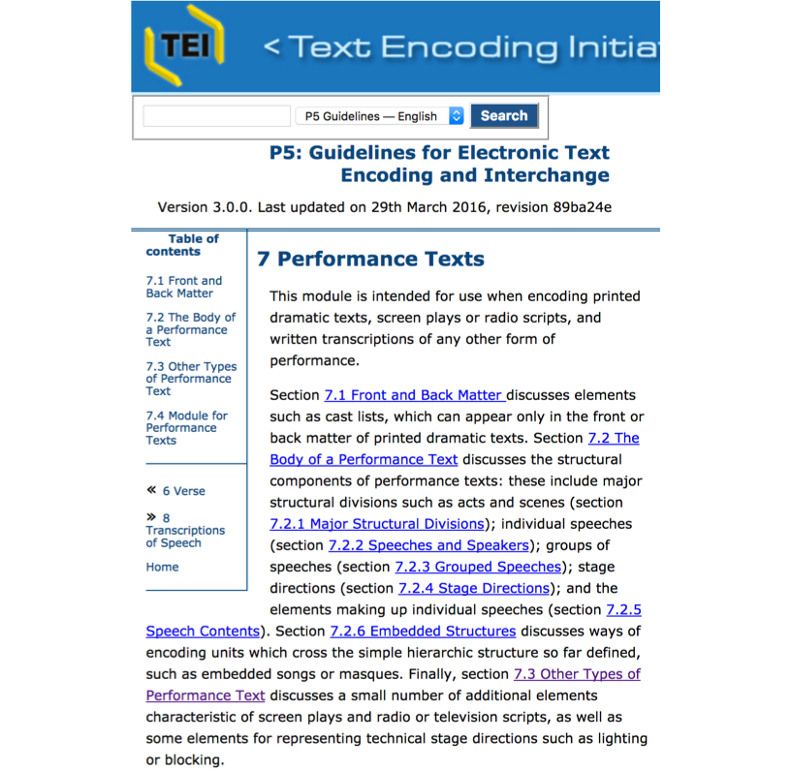
Guidelines for Electronic Text Encoding and Interchange (TEI): TEI module for Performance text
Prologue
Epilogue
Performance
Description of setting, time, locale, etc.
Cast list
Speeches and speakers
Stage directions

Slide 17
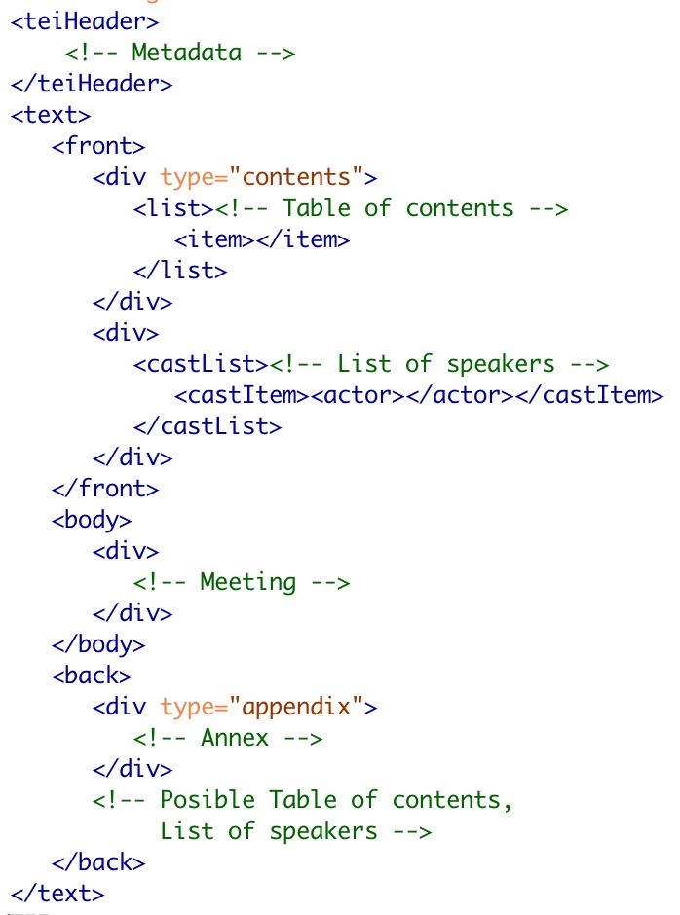
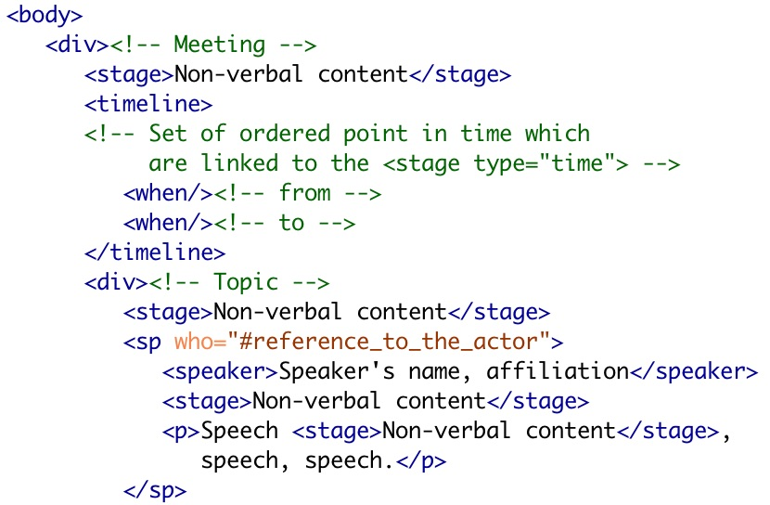
Annotation: Using TEI module for Performance text

Slide 18
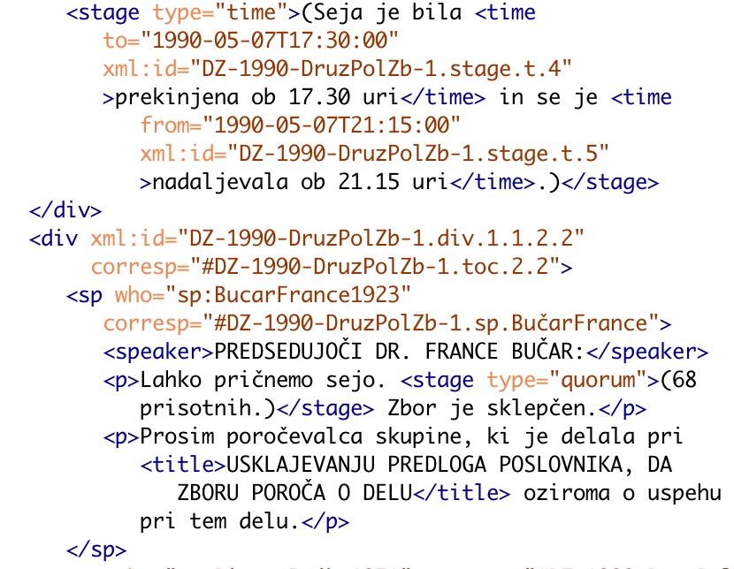
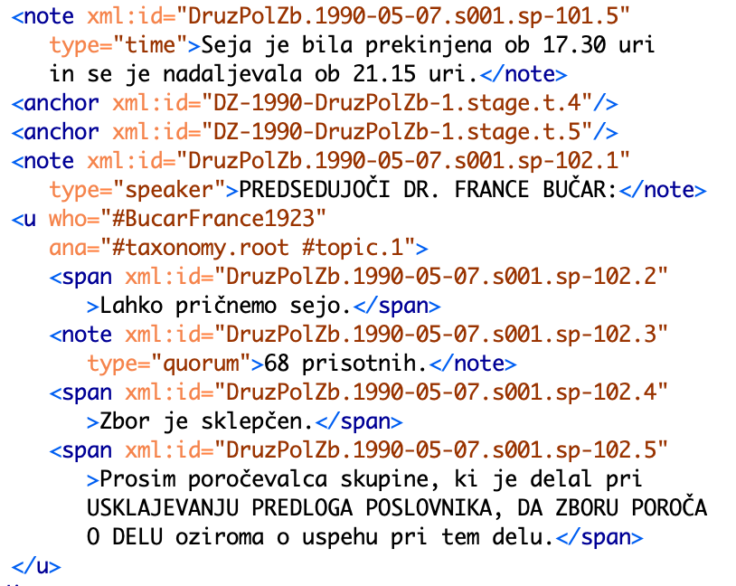
XSLT stylesheet: conversion from the source TEI drama-encoded corpus to the target TEI speech-encoded corpus
TEI drama
TEI speech

Slide 19
Let's start to make parliamentary corpus!
Learning material is available in GitHub repository https://github.com/DARIAH-SI/CPC
Low-level tutorial:
Original parliamentary records in PDF or Word file
Basic annotation in Word file
Automatic conversion to TEI
Additional annotation in TEI document
Example of semi-automatic annotation with XSLT stylesheets

